Slide 1
Ch.8 TESTING THE PROGRAMS

Slide 2
8.1 Software Fault and failures
The persistence of faults is a fact, because the size of project and the number of people involved add complexity to develop project
What is software failure?
  the software does not do what the requirements describe.
The reasons caused failure
  Wrong specification or missing requirement
  Impossible to implement requirement
  The system design contains a fault
  The program design contains a fault
  The program code maybe be wrong

Slide 3
Software Fault and failures
We test a program to demonstrate the existence of a fault, the goal is to discover fault, Not to demonstrate the program perform properly.
  Objective of testing: discover faults
  A test is successful only when a fault is discovered
Fault identification
  Fault identification is the process of determining what fault caused the failure
Fault correction(removal)
  Fault correction is the process of making changes to the system so that the faults are removed

Slide 4
Types of faults
Algorithmic fault
Syntax faults
Computation and precision faults
Documentation faults
Stress or overload faults
Capacity or boundary faults
Timing or coordination faults
Throughput or performance faults
Recovery faults
Hardware and system software faults
Standards and procedure faults

Slide 5
Orthogonal defect classification
Orthogonal defect classification help you identify the fault is belonged to which exactly one category. So it helps improve the entire development process by telling us which types of faults are found in which development activities.
Essentially, Orthogonal is a kind classification which any item can be classified belongs to exactly one category.

Slide 6
8.2 Testing Issues
Test organization
  Module testing, component testing, or unit testing
  Integration testing
  Function test
  Performance test
  Acceptance test
  installation test
Notes:
this section introduces some testing related issues, to help you understand all aspects of the test.

Slide 7
Testing Issues
Attitudes toward testing
  Hurt feelings and bruised egos have no place in the development process as faults are discovered.
  Egoless programming, where programs are viewed as components of a larger system, not as the property of those who wrote them.
  When a fault is discovered or a failure occurs, the egoless development team is concerned with correcting the fault, not with placing blame on a particular developer.

Slide 8
Testing Issues
Who performs the test?
  we sometimes have difﬁculty removing our personal feelings from the testing process. Thus, we often use an independent test team to test a system.
  Independent test team to test a system
    avoid conflict
    improve objectivity
    allow testing and coding concurrently
Views of the test objects
  Black box (closed box)
  Open box (white box, clear box)
Notes:
we may be too close to the code to be objective and to recognize some of the more subtle faults. that's mean you are not sensitive to your own coding errors, so you make such mistakes.

Slide 9
8.3 unit testing
Examining the code(code review)
  Code Walkthroughs
    In a walkthrough, you present your code and accompanying documentation to the review team, and the team comments on their correctness. During the walkthrough, you lead and control the discussion. The atmosphere is informal, and the focus if attention is on the code, not the coder.

Slide 10
8.3 unit testing
Examining the code(code review)
  Code inspections
    Is similar to a walkthrough but is more formal. In an inspection, the review team checks the code and documentation against a prepared list of concerns.
    Inspection code usually involve steps. First , the team may meet as a group for an overview of the code and a description of the inspection goals, then team members prepare individually for a second group meeting, each inspector studies the code and its related documents, noting faults found. Finally, in a group meeting, team members report what they have found, recording additional faults discovered in the process of discussing individuals’ findings.

Slide 11
8.3 unit testing
Examining the code(code review)
  success of code reviews
    Reviews have been shown to be extraordinarily successful at detecting faults
Discovery Activity | Fault Found per Thousand Lines of Code
Requirements review | 2.5
Design Review | 5.0
Code inspection | 10.0
Integration test | 3.0
Acceptance test | 2.0

Slide 12
8.3 unit testing
Proving code correct（Omit）
  Correct
  Formal proof techniques
    Advantages and disadvantages of correctness proofs
  Other proof techniques
    Symbolic execution
    Automated theorem proving
In most cases, it is impossible to prove a program being correct.
In the near future, development teams are more likely to be concerned with testing their software rather than with proving their programs correct.

Slide 13
8.3 unit testing
Testing program component
  to test a component, we choose input data and conditions, allow the component to manipulate the data, and observe the output. We select the input so that the output demonstrates something about the behavior of the code.
  Choosing test cases
    Test case
      Is a particular choice of input data to be used in testing a program.
    Test
      Is a finite collection of test cases.
    equivalence class to separate the input
      For example, when testing the absolute value function, positive numbers, zero, and negative numbers are 3 equivalence classes.
    Combine open- and closed-box testing to generate test data.

Slide 14
8.3 unit testing
Test thoroughness
  Statement testing
    Every statement in the component is executed at least once in some test
  Branch testing
    For every decision point in the code, each branch is chosen at least once in some test
  Path testing
    Every distinct path through the code is executed at least once in some test

Slide 15
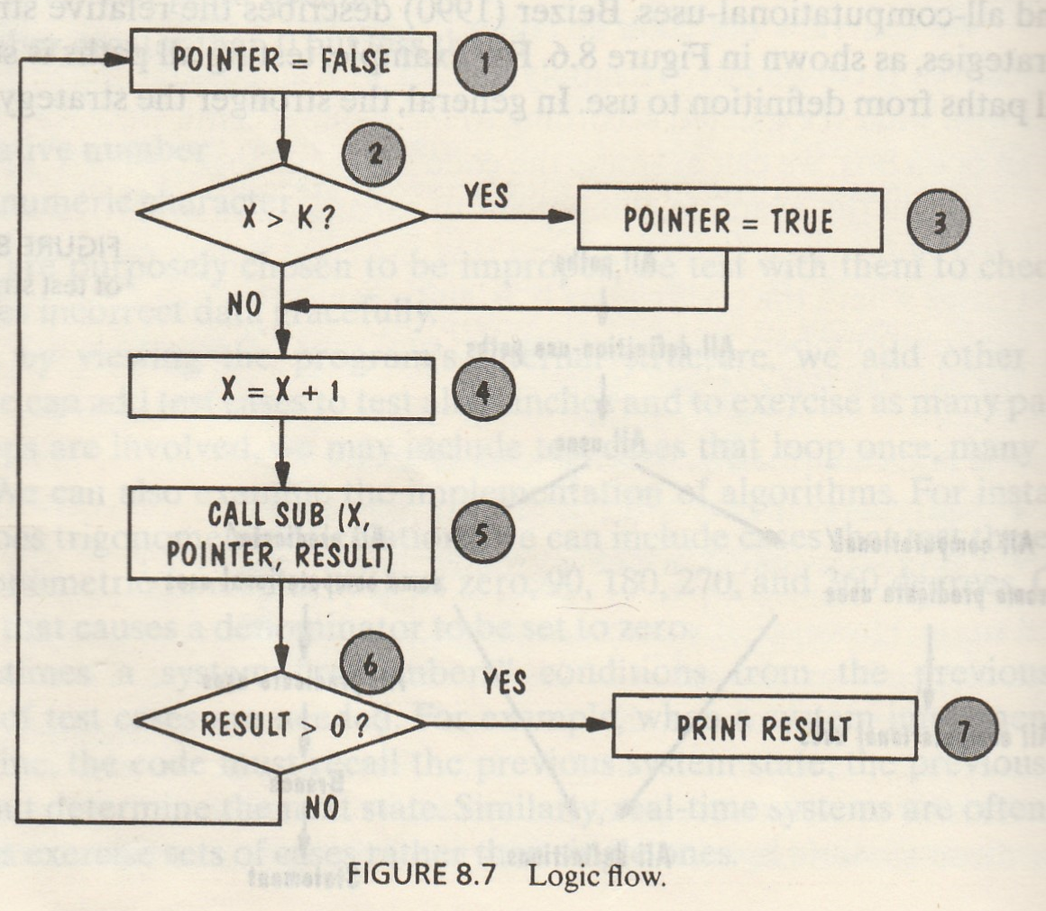
Test thoroughness
Statement testing ：
1-2-3-4-5-6-7 （true-true）
Branch testing：
1-2-3-4-5-6-7（true-true）
1-2-4-5-6-1（false-false）
Path testing：
1-2-3-4-5-6-7 （true-true）
1-2-3-4-5-6-1 （true-false）
1-2-4-5-6-7 （false-true）
1-2-4-5-6-1 （false-false）

Slide 16
8.4 integration testing
Bottom-up integration
  Bottom-up testing
  Component driver
    a routine that calls a particular component and passes a test case to it
  A frequent complaint about bottom-up testing in a functionally decomposed system is that the top-level components are usually the most important but the last to be tested.
Top-down integration
  Top-down approach
  Stub
    a special-purpose program to simulate the activity of the missing component
  A disadvantage to top-down testing is the possibility that a very large number of stubs may be required.
Notes:
When we are satisﬁed that individual components are working correctly and meet our objectives, we combine them into a working system.

Slide 17
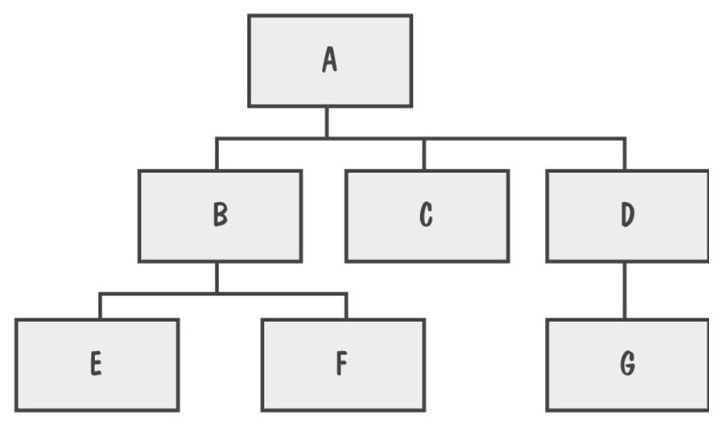
System viewed as a hierarchy of components

Slide 18
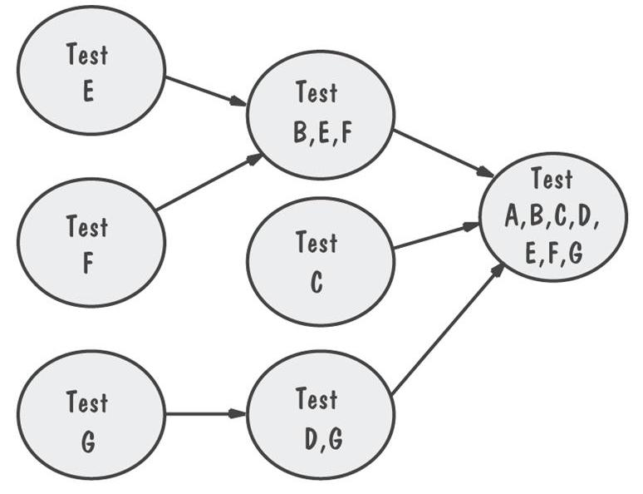
Bottom-Up Integration Example
Bottom-up testing

Slide 19
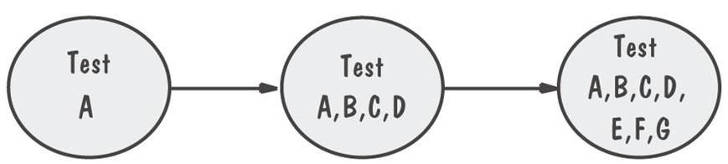
Top-Down Integration Example
Top-down testing

Slide 20
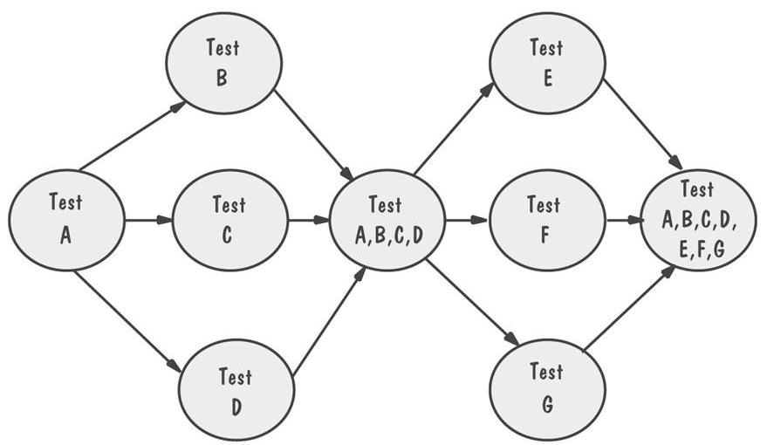
Modified Top-Down Integration Example
Test each level’s components individually before the merger takes place, to reduce the number of stubs.

Slide 21
8.4 integration testing
Big-bang integration
  When all components are tested in isolation, it is tempting to mix them together as the ﬁnal system and see if it works the ﬁrst time.
  It is only applied to small system
  Big-Bang Integration method is not recommended for any system, because all components are merged at once, it is difﬁcult to ﬁnd the cause of any failure.
  It is applied to small system

Slide 22
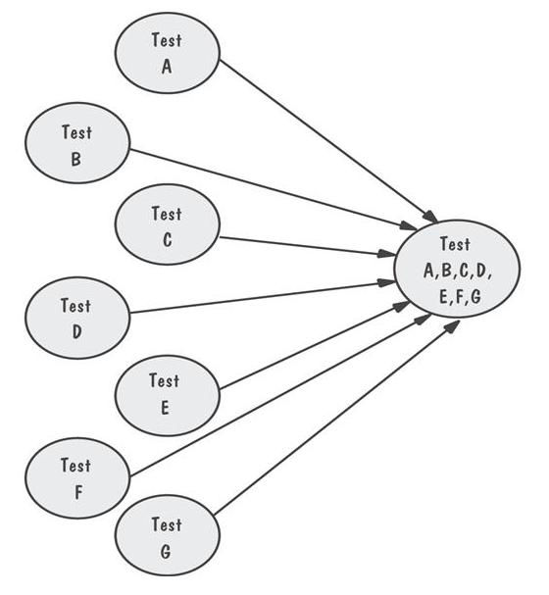
Bing-Bang Integration Example
Requires both stubs and drivers to test the independent components

Slide 23
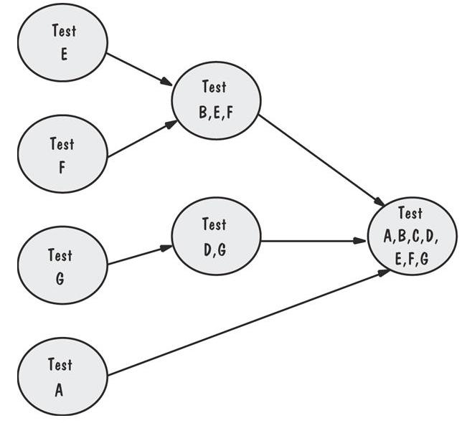
Sandwich Integration Example
Combination of Bottom-up and Top-down strategy
Viewed system as three layers

Slide 24
8.5 testing object-oriented system
Many of the techniques we have described for testing systems apply to all types of systems, including object-oriented ones.
Testing the code
  Take into account the object states needed to test classes
  Beware of concurrency and synchronization problems

Slide 25
8.5 testing object-oriented system
Difference between object-oriented and traditional testing
  when we add a new subclass or modify an existing subclass, we must retest the methods inherited from each of its ancestor super classes.
  When a subclass replaces an inherited method with a locally deﬁned method with the same name, the overriding subclass must be retested, and probably with a different set of test data.
Graham summarizes the differences between object-oriented and traditional testing in two ways, Which aspects of object orientation make testing easier and which make it harder, Figure 8.16, P435

Slide 26
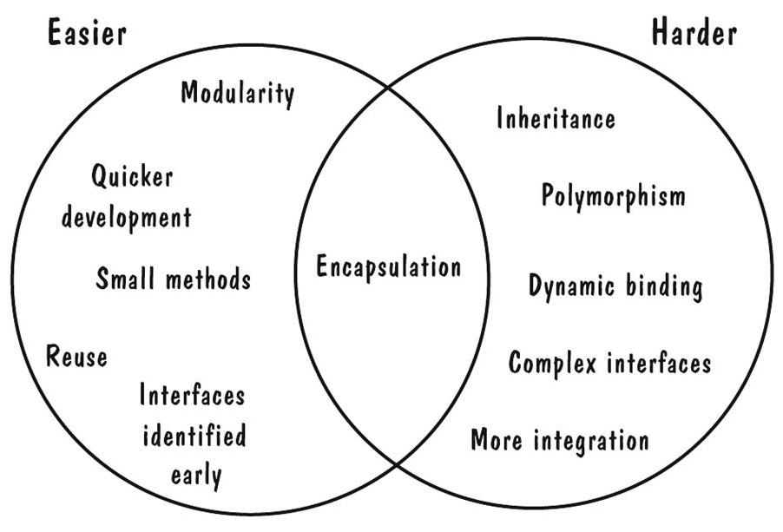
Easier and Harder Parts of Testing OO Systems
Figure 8.16

Slide 27
8.6 test planning
The testing process
  Establishing test objectives
    The test objective tells us what kinds of test cases to generate.
  Designing test cases
    the test case design is key to successful testing, If test cases are not representative and do not thoroughly exercise the functions, then the remainder of the testing process is useless.
  Writing test cases
  Testing test cases
    running a test begins with reviewing the test cases to verify that they are correct, feasible, provide the desired degree of coverage, and demonstrate the desired functionality
  Executing tests
    Once these checks have been made, we can actually execute the tests.
  Evaluating test results

Slide 28
8.6 test planning
Purpose of the plan
  Organize testing activities
  The test plan describes the way in which we will show our customers that the software works correctly. (i.e., that the software is free of faults and performs the functions as speciﬁed in the requirements).
  the plan is a guide to the entire testing activity,It explains:
    who does the testing,
    why the tests are performed,
    how the tests are conducted,
    when the tests are scheduled.

Slide 29
Contents of the test plan
Contents of the plan
  The system test plan begin with the test objective(测试目标), addressing each type of testing from unit through functional to acceptance and installation testing.
  The plan looks at how the test will be run（如何执行测试） and what criteria（结束标准） will be used to determine when the testing is complete.
  The test plan describes in detail the methods（详细描述用于测试的方法） to be used to perform each test.
  The test plan also explains how test data will be generated and how any output data or state information will be captured.（如何产生测试数据以及如何收集输出结果和状态信息）
The test plan gives a complete picture of how and why testing will be performed.

Slide 30
8.7 automated testing tools
Code analysis tools
  Static analysis
    Several tools can analyze a source program before it is run. Tools that investigate the correctness of a program or set of components can be grouped into four types:
    1)Code analyzer: The components are evaluated automatically for proper syntax.
    2)Structure checker: This tool generates a graph from the components submitted as input. The graph depicts the logic ﬂow, and the tool checks for structural ﬂaws.
    3)Data analyzer: The tool reviews the data structures, data declarations, and component interfaces.
    4)Sequence checker: The tool checks sequences of events;

Slide 31
8.7 automated testing tools
Code analysis tools
  Dynamic analysis
    Automated tools enable the test team to capture the state of events during the execution of a program by preserving a “snapshot” of conditions.
    These tools are sometimes called program monitors because they watch and report the program's behavior.
    Program monitors
      Program monitors watch and report the program’s behavior.
      Program monitors provide information about statement, path, branch coverage.

Slide 32
8.7 automated testing tools
Test execution tools
  Capture and replay
  Generating stubs and drivers automatically
  Automated testing environment
    Test execution tools can be integrated with other tools to form a comprehensive testing environment.
Test case generators
  Structural test case generator base their test cases on the structure of the source code, they list test cases for path, branch, or statement testing, and they often includes heuristics to help us get the best coverage.

Slide 33
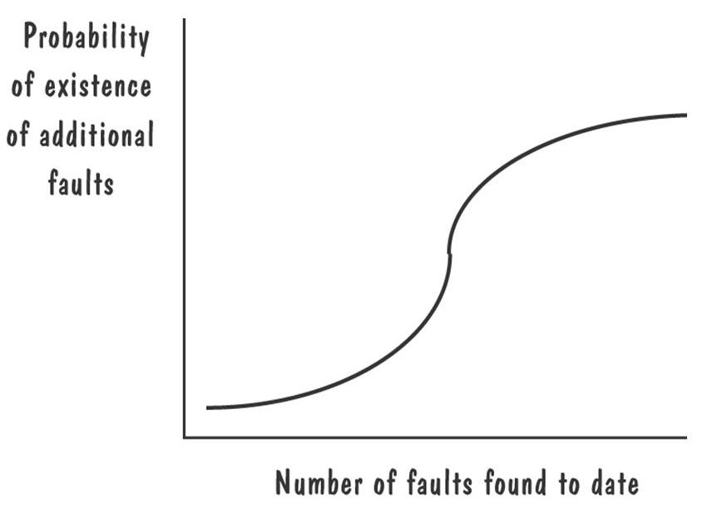
8.8 when to stop testing
As the number of detected faults increases, the probability of the existence of more undetected faults increases, figure 8.19.
Notes:
the graph shows us that if we ﬁnd a large number of faults at the beginning, then we are likely still to have a large number undetected.

Slide 34
8.8 when to stop testing
Fault seeding, the test team intentionally inserts (or “seeds”) a known number of faults in a program. Then, the other team members locate as many faults as possible. The number of undiscovered seeded faults acts as an indicator of the number of total faults (including indigenous, nonseeded ones) remaining in the program. That is, the ratio of seeded faults detected to total seeded faults should be the same as the ratio of nonseeded faults detected to total nonseeded faults:
detected seeded Faults ₌ detected nonseeded faults
    total seeded fault total nonseeded faults

Slide 35
8.8 when to stop testing
Confidence in the software
  Suppose we have seeded a program with S faults, and we claim that the code has only N actual faults. We test the program until we have found all S of the seeded faults. If, as before, n is the number of actual faults discovered during testing, then the conﬁdence level can be calculated as：
  C = 1, if n >N
  C = S/(S – N + 1) if n ≤ N

Slide 36
8.8 when to stop testing
Other stopping criteria
  The test strategy can be used to set stopping criteria for testing. For example, when we are doing statement, path, or branch testing, we can track how many statements, paths, or branches need to be executed and determine our test progress in terms of the number of statements, paths, or branched left to test.
Identifying fault-prone code
  Porter and Selby suggest the use of classiﬁcation trees to identify fault- prone components.
  Figure 8.20, P446

